Slide 1
House of Pies Exercise
Python - Lesson 2 – Activity 4
Gustavo Maldonado

Slide 2
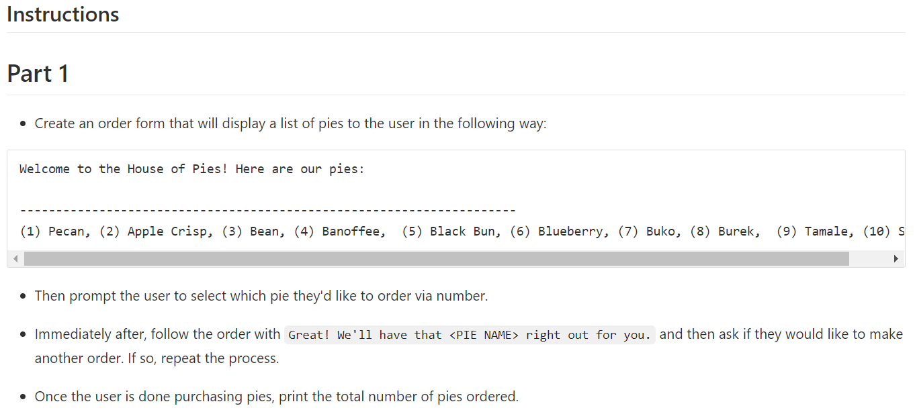
Instructions:

Slide 3


Define variables in advance:
shopping: in this case is it helps us to save the answer for our user.
Variable 1 define by =.
Variable 1
pie_purchases: in this variable the user option will be storage.
Variable 2 define by =.
The parameter is defined by [ ], because inside of it we are going to storage the chosen options.
Variable 2

Slide 4


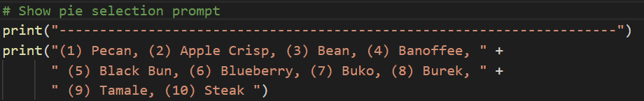
List: are defined by [ ], the order (vertical or horizontal) doesn’t make any difference.
pie_list: define your variable 3 using =.
Always add , at the end of each list, except the last value.
If is a string value (text), add “ ” in between.
Print a welcome message & options.
Remember to use always ( ) and “ “ for write a message.

Slide 5
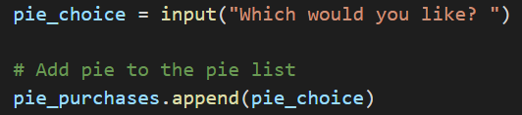


Append or Concatenate the options:
Use variable 2, pie_pruchase [ ] to save the options obtained in the input.
pie_choise: defined as variable 4, here the option will be received.
append fucntion: requires previous define variable, also . in between and ().
APPEND:
RESULT:
$$pie_purchase.append(pie_choise)$$
$$pie_purchase.append(1)$$
$$pie_purchase[1,2,3,…]$$
*Saves the input as list because of [ ]

Slide 6
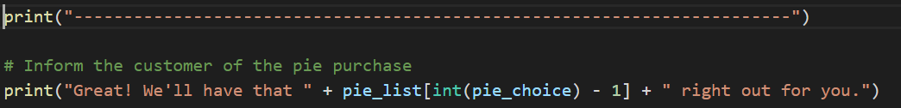

Print the option the user choose:
We need to concatenate the text and options with +.
FORMULA:
RESULT:
$$pie_list[int\left(pie_choise\right)−1]$$
$$pie_list[int\left(1\right)−1]\text{:}$$
$$pie_list[0]\text{:}$$
*In python the start counting number is 0, that is why we need to subtract from the chosen option.

Slide 7
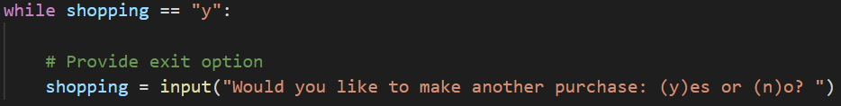
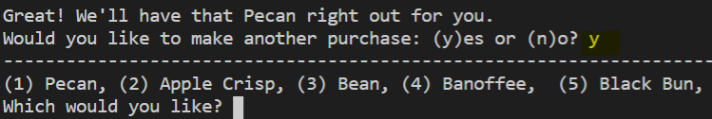
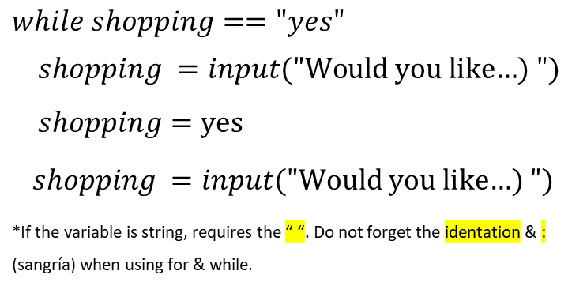
While – Ask ir the person wants another pie:
shopping: variable 1, set as “yes” for asking the user if the want an extra pie.
while: the iteration occurs while the parameter is met.
DEFINE VAR & ASK INPUT:
RESULT:
$$while shopping=="yes"$$
$$shopping =input(\text{"}\text{Would} \text{you} \text{like}\text{…) }")$$
$$shopping=\text{yes}$$
$shopping =input(\text{"}\text{Would} \text{you} \text{like}\text{…) }")$
*If the variable is string, requires the “ “. Do not forget the identation & : (sangría) when using for & while.

Slide 8


Print the options the user choose:
We need to concatenate the text and options with +.
FORMULA:
RESULT:
$$str(len(pie_purchases))$$
$$str(len(1,3,6))$$
$$str\left(3\right)$$
$$"3"$$

Slide 9
BONUS

Slide 10
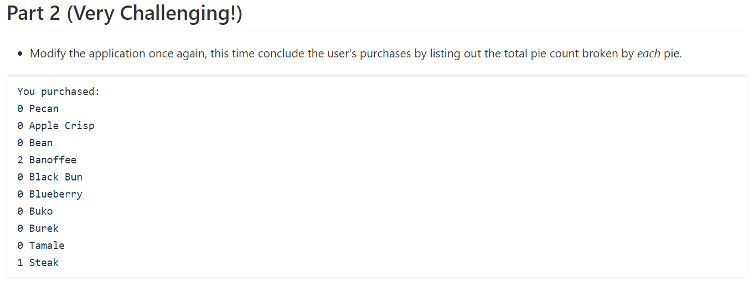
Instructions:

Slide 11


Reset & define variables:
pie_purchases: in this variable the user option will be storage.
Variable 2 define by =.
The parameter is defined by [0,0,0,0,0,0,0,0,0,0], according with the list of options the user has.
Variable 2
choice_index: in this variable 5 the substract of 1 is done.
The parameter is defined as integer int, because the options always returns as string. This way the calculations are able to make.
Variable 5

Slide 12
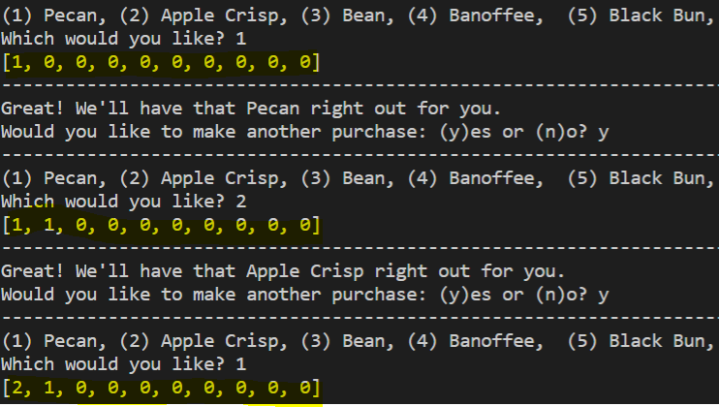

Calculation & Result:
Redefined pie_purchases: in this variable the user option will be storage.
The parameter is defined by [ ], because inside of it we are going to storage the chosen options.
FORMULA:
RESULT:
$$pie_purchases[choice_index]+=1$$
$$pie_purchase\left[choice_index\right]=pie_purchase[choice_index]+1$$
$$pie_purchases[0]$$
$$pie_purchases[choice_index]+=1$$
$$pie_purchases\left[0\right]+\left[0\right]$$
$$pie_purchases\left[0+0\right]$$
*The options will be adding and storing in variable pie_purchase.

Slide 13
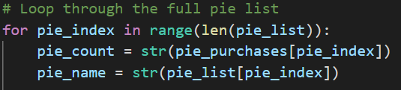
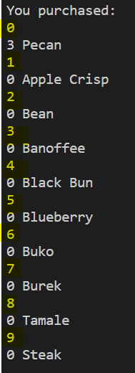

For Iteration 1 – list the options:
pie_index: variable 6, it will help to allocate the chosen options.
LOOP:
RESULT:
$for pie_index in range(len\left(pie_list\right))$:
$for pie_index in range(len\left(10\right))$:
$for pie_index in range(10)$:

Slide 14
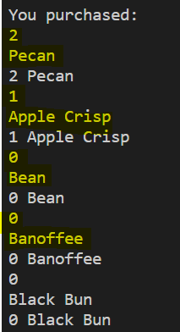
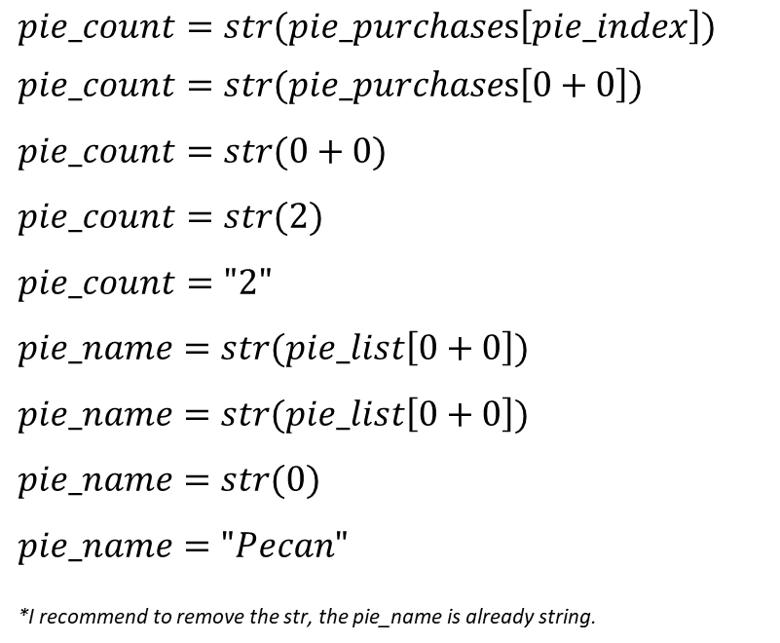
Set variables:
pie_count: variable 7 to save & show the the number of chosen options.
pie_name: variable 8 to save & show the the name of chosen options.
FORMULA:
RESULT:
$$pie_count=str(pie_purchases\left[pie_index\right])$$
$$pie_count=str(pie_purchases\left[0+0\right])$$
$$pie_count=str(0+0)$$
$$pie_count=str(2)$$
$$pie_count="2"$$
$$pie_name=str(pie_list\left[0+0\right])$$
$$pie_name=str(pie_list\left[0+0\right])$$
$$pie_name=str(0)$$
$$pie_name="Pecan"$$
*I recommend to remove the str, the pie_name is already string.

Slide 15
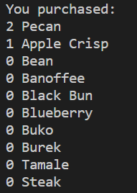

Print the options the user choose:
We need to concatenate the text and options with +.
PRINT:
RESULT:
$$print(pie_count +\text{" " }+pie_name)$$
$$print(2 +\text{" " }+Pecan)$$
$$"2 Pecan"$$

